Slide 1
Minor Project
Project title –> Judge-Me-Not
Made By :- Guided By:-
Anurag Arora (161B040) Kunj Bihari Meena Sir
Ayush Singh (161B061)
Dev Agarwal (161B071)

Slide 2
Introduction:-
Our project, as the name (‘JUDGE ME NOT’) suggest is something that judges something and other cannot comment or complain on that . It return bool value i.e. true or false to the user’s answers .
This project basically judges the problem sets based on C, C++, Python, Java or can say it is an automated system to run programming contests.

Slide 3
Aim
The aim of our project is to automated judge system to run programming contests. It has a mechanism to submit problem solutions, have them judged fully automatically and provides interfaces for teams, the jury and the general public.

Slide 4
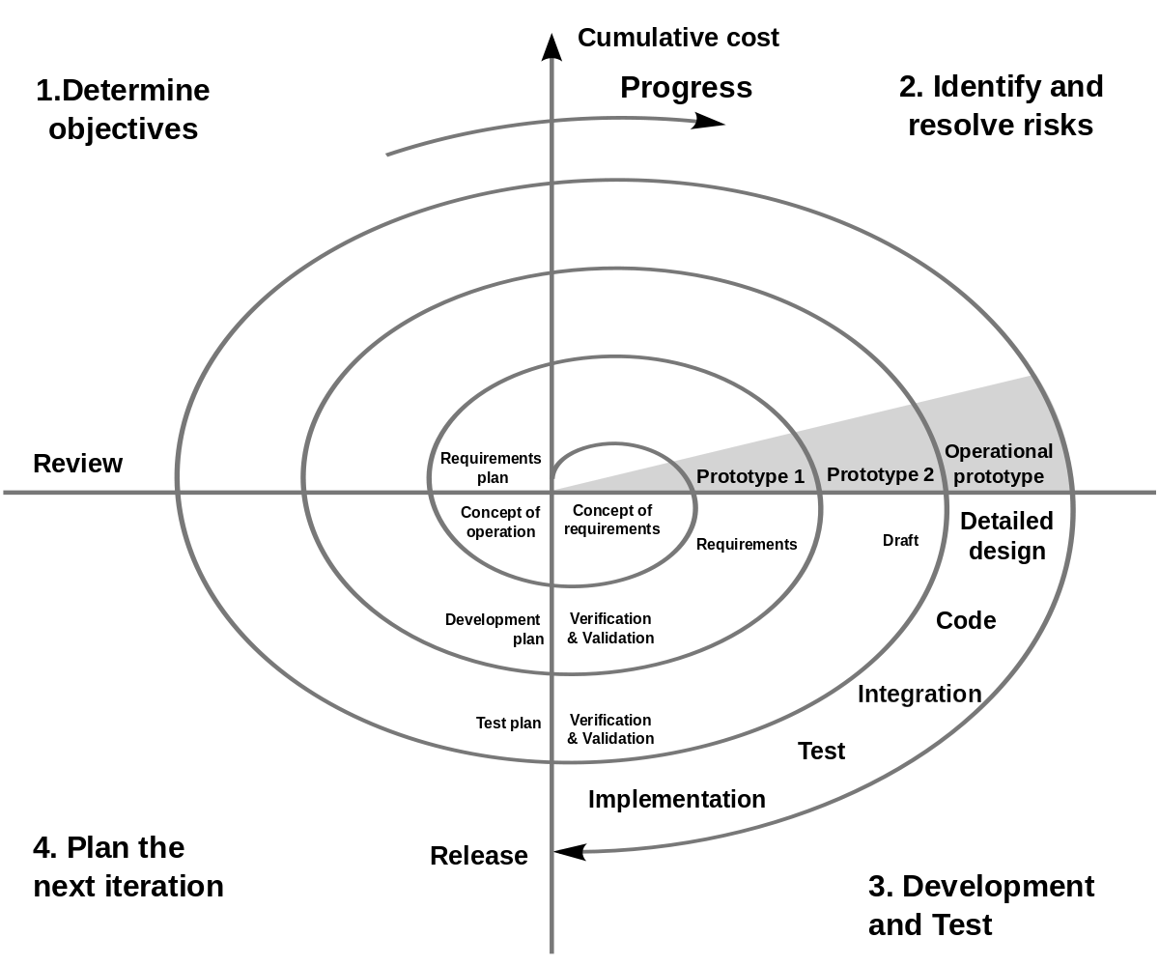
Model for our project:
As per our requirement ,our project follows the spiral model which requires analysis time to time once the project is ready and it also provides support for risk handling.

Slide 5
Similar Softwares:
CodeOJ Judge
PC^2
Dom Judge

Slide 6
How is our project different from others:
User Friendly.
Easy to set up.
Prerequisite are very less.
Open source.
Windows Compatible.

Slide 7
Requirements:
First GCC, G++, Java-compiler (JDK), Python has to be installed on admin’s system(one which judge is to be established).
Second Django must be configured.
Third server must be established.

Slide 8
How our project will work?
User interface
Login Panel
Language Selection
Test solution
Submit for evaluation

Slide 9
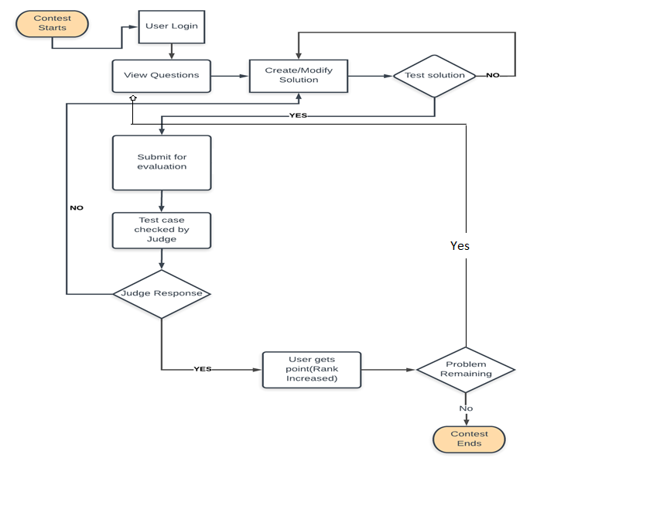
Flow Chart

Slide 10
AC - Accepted
Your program passed testing! In some cases, this may be accompanied with additional feedback from the grader.
WA - Wrong Answer
Your program did not crash while executing, but the output it produced was wrong. As for AC, this may be accompanied with additional feedback stating what you did wrong.

Slide 11
RTE - Runtime Exception
Your program caused a runtime exception to occur. This will only occur for native languages like C or C++. DMOJ maps many common RTEs to more useful descriptions, described below.
OLE - Output Limit Exceeded
Your program did not crash while executing, but the output it produced was wrong. As for AC, this may be accompanied with additional feedback stating what you did wrong.

Slide 12
MLE - Memory Limit Exceeded
Your program ran out of memory. Sometimes, this might manifest itself as an RTE with segmentation fault or bad allocation (std::bad_alloc).
TLE - Time Limit Exceeded
Your program took too long to execute.
IE - Internal Error
If you see this, it means either the judge encountered an error or the problem setter's configuration is incorrect. Possible the judge may not to properly set up.

Slide 13
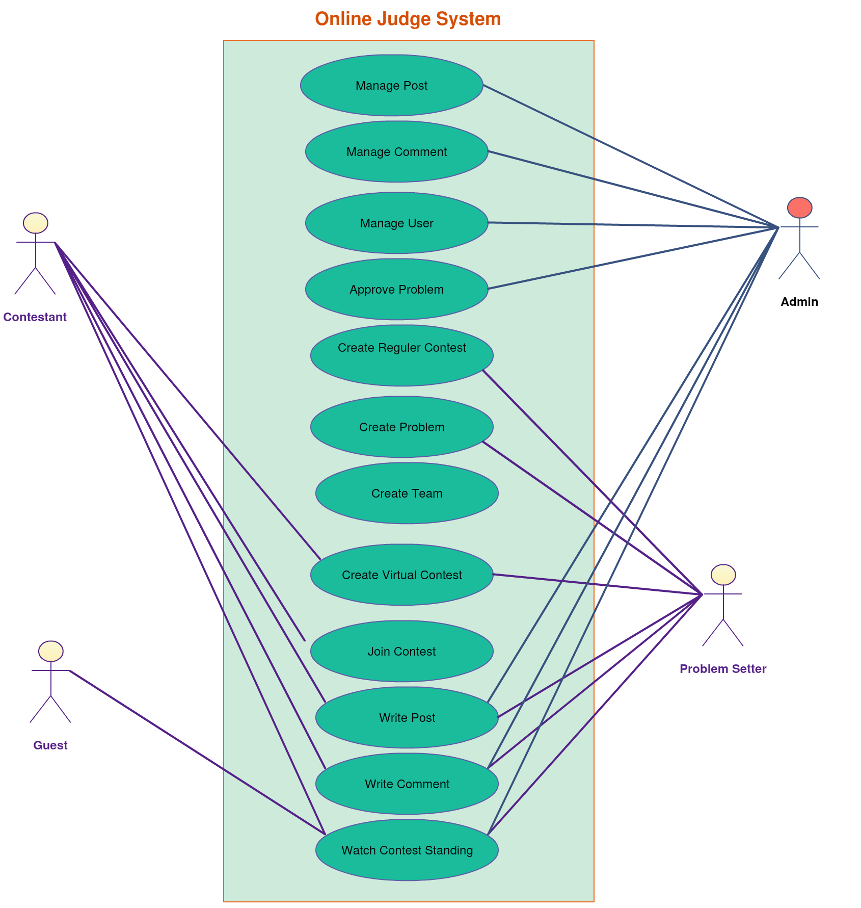
U
M
L

Slide 14
Data Flow Diagram

Slide 15
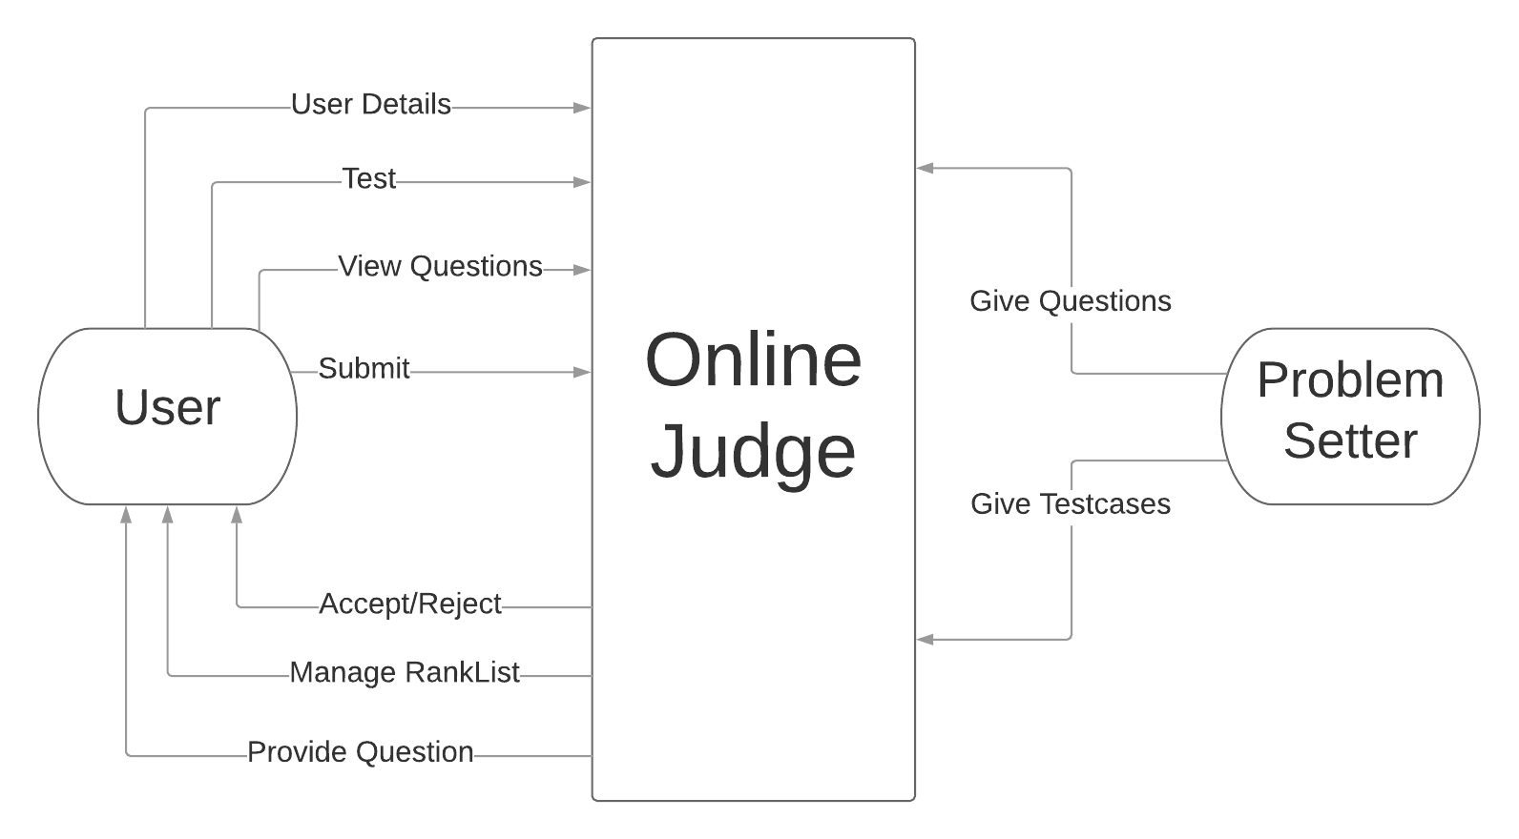
Level 0

Slide 16
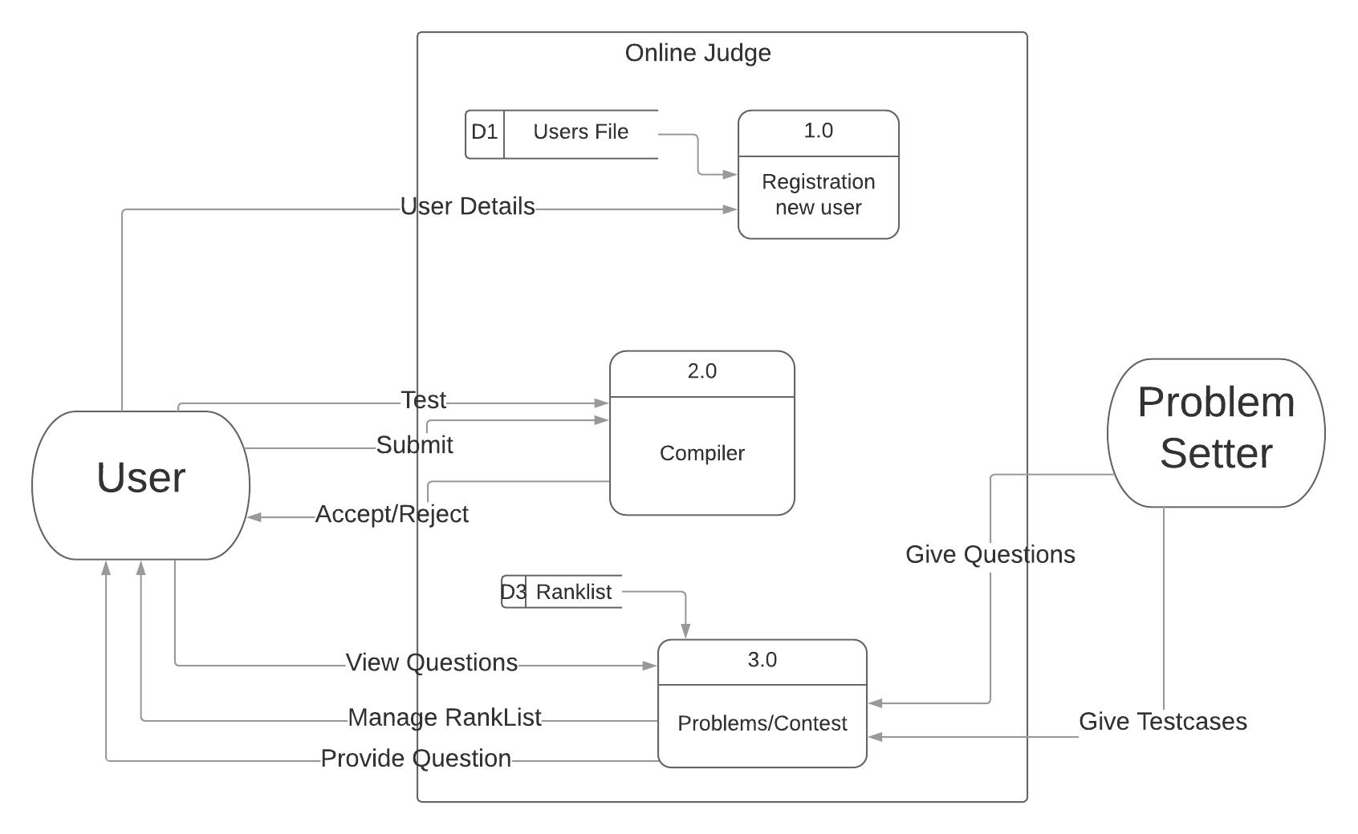
Level 1

Slide 17
Screenshots

Slide 18
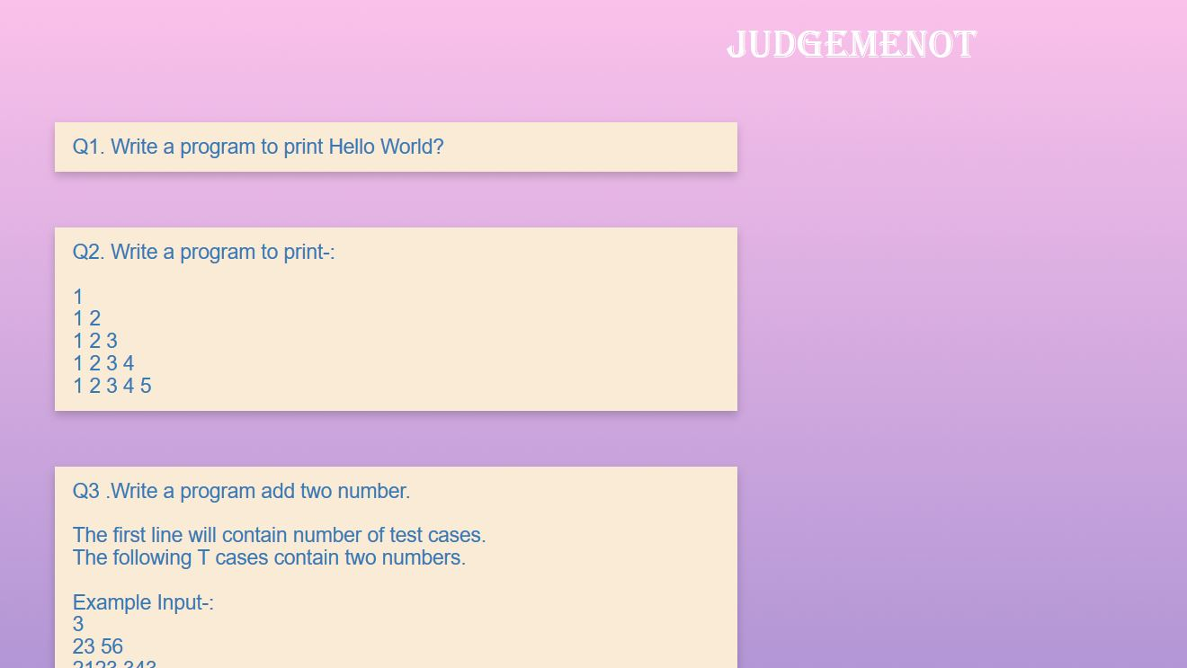
Home Screen

Slide 19
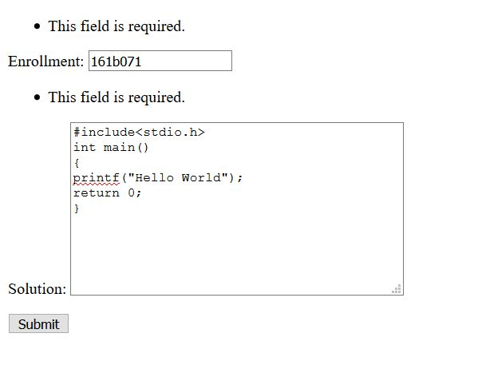
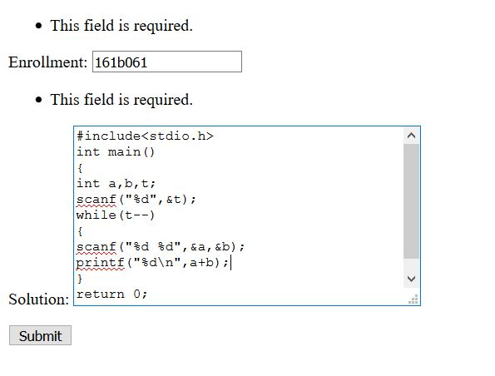
Submit Solution

Slide 20
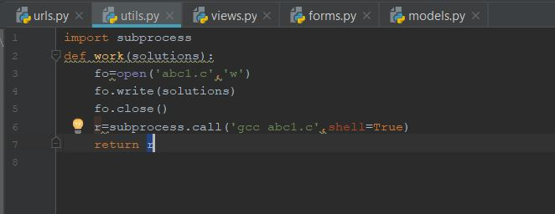
Working

Slide 21
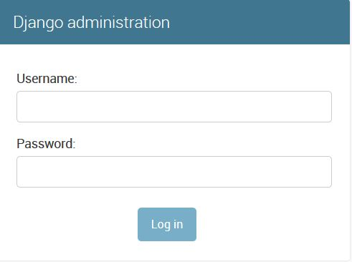
Admin Authentication

Slide 22
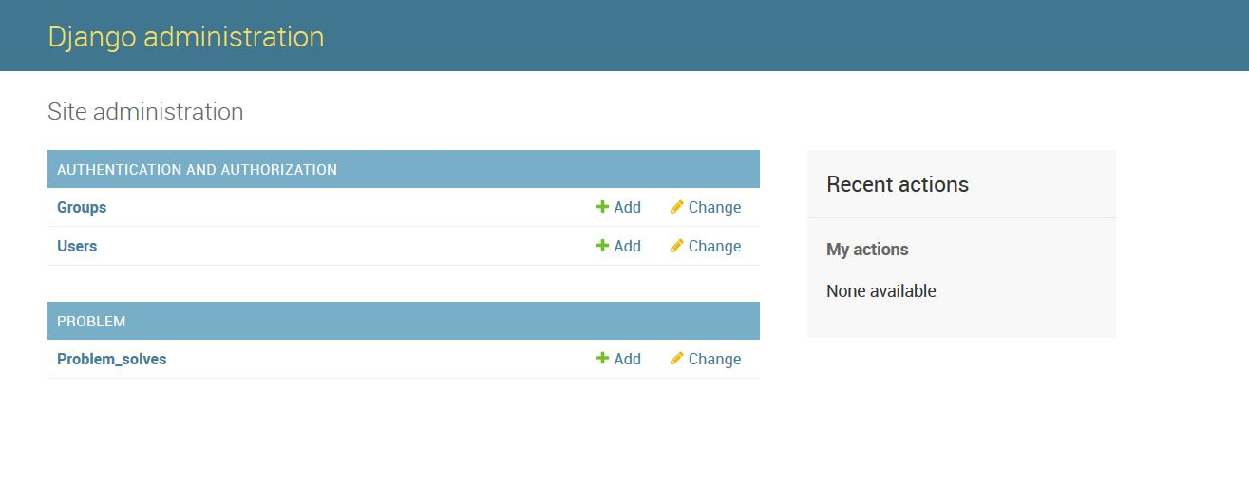
Admin Home Screen

Slide 23
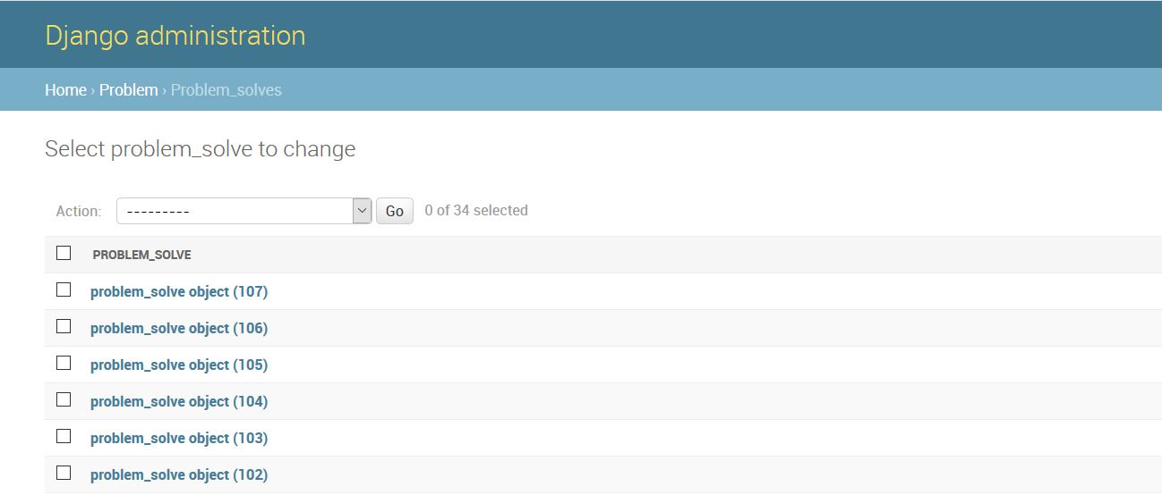
Total Submissions

Slide 24
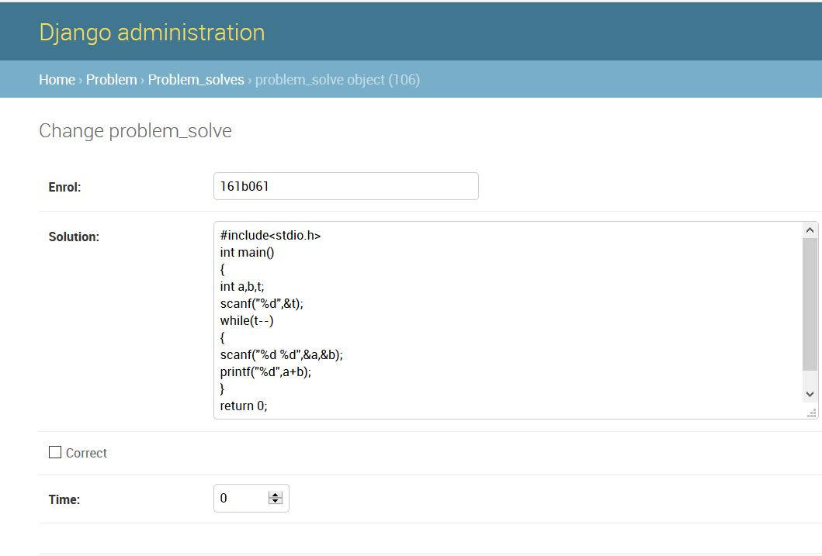
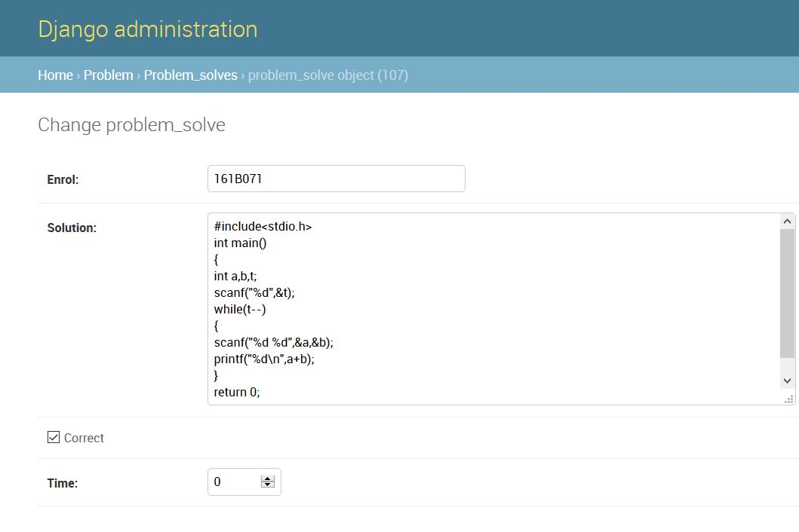
Recent Submissions

Slide 25
Conclusion:
This project automates the coding contest and makes easy to conduct the competitions in college/school/organizations.

Slide 26
Thank You !!

